Slide 1

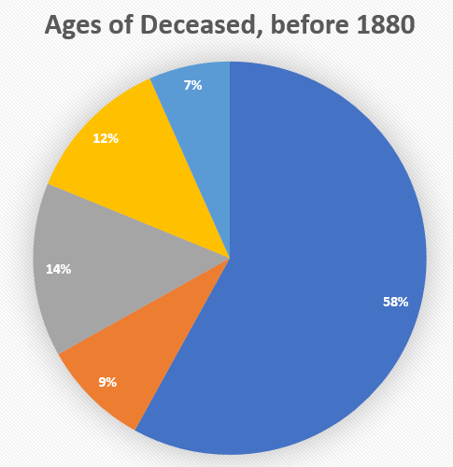
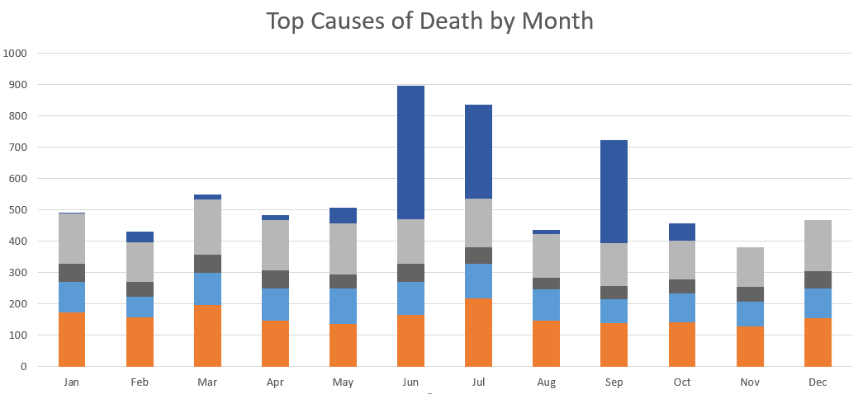
Life was different 160 years ago when most of those laid to rest here were buried – and it was death itself that made life so different – life expectancy, war and disease created a world those of us alive now would not recognize! Come learn more about those buried here and the precarious lives they lived at the Nashville City Cemetery!
What caused so many Nashvillians under 18 to die in the years before 1880?
What did Nashvillians die of before modern medicine?
What killed Nashvillians in the summer?

Slide 2
What did Nashvillians die of before modern medicine?
What caused so many Nashvillians under 18 to die in the years before 1880?
What killed Nashvillians in the summer?
Life was different 160 years ago when most of those laid to rest here were buried – and it was death itself that made life so different – life expectancy, war and disease created a world those of us alive now would not recognize! Come learn more about those buried here and the precarious lives they lived at the Nashville City Cemetery!

